Slide 1

MACHINE LEARNING · SEMESTER 2 · EMLDS PROGRAMME
Fine-Tuning Flan-T5 for Code Intelligence Using LoRA
Parameter-Efficient Adaptation for Python Code Generation & Text-to-SQL

Slide 2

Problem & Approach
We fine-tuned google/flan-t5-base (250M parameters) on two code tasks using LoRA:
Python Code Generation
SQL Query Generation from NL
Multi-Task Training
Python generation (MBPP) and Text-to-SQL (SPIDER) trained jointly on a combined, shuffled dataset.
Parameter Efficiency
LoRA Configuration
Only 1.4% of parameters trainable — ~3.5M of 250M. Feasible on a single T4 GPU.
Rank=16, alpha=32, targeting query & value matrices. LR=3e-4, 5 epochs, batch=32, fp32.
Notes:
— freezing the base model and injecting trainable low-rank matrices into attention layers.

Slide 3
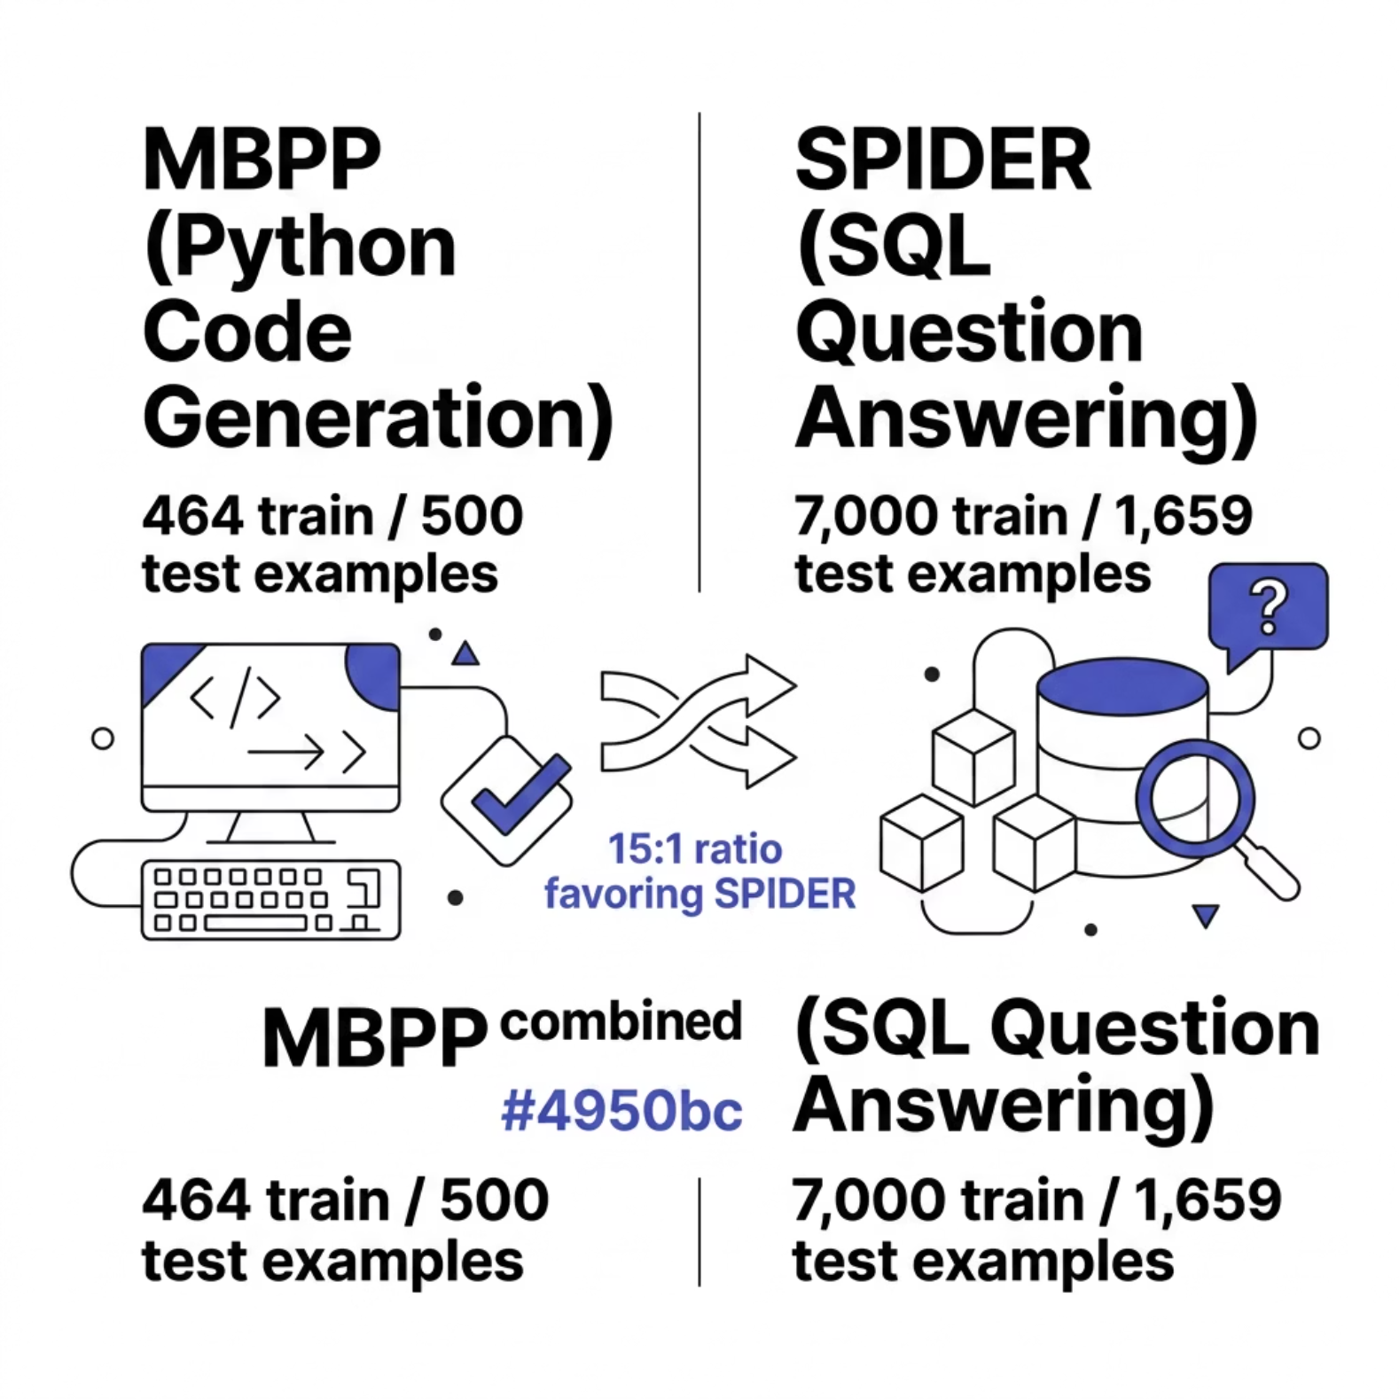


Datasets
MBPP — Python Generation
464 train / 500 test examples. Generate Python from natural language with test assertions.
Prompt: "Generate Python: {description} + Test cases: {assertions}"
SPIDER — Text-to-SQL
7,000 train / 1,659 test examples. Translate questions to SQL given a schema.
Prompt: "Translate to SQL: {question} + Schema: {tables/columns}"
Both datasets preprocessed into unified JSONL, combined, and shuffled. SPIDER:MBPP ratio ≈ 15:1.

Slide 4
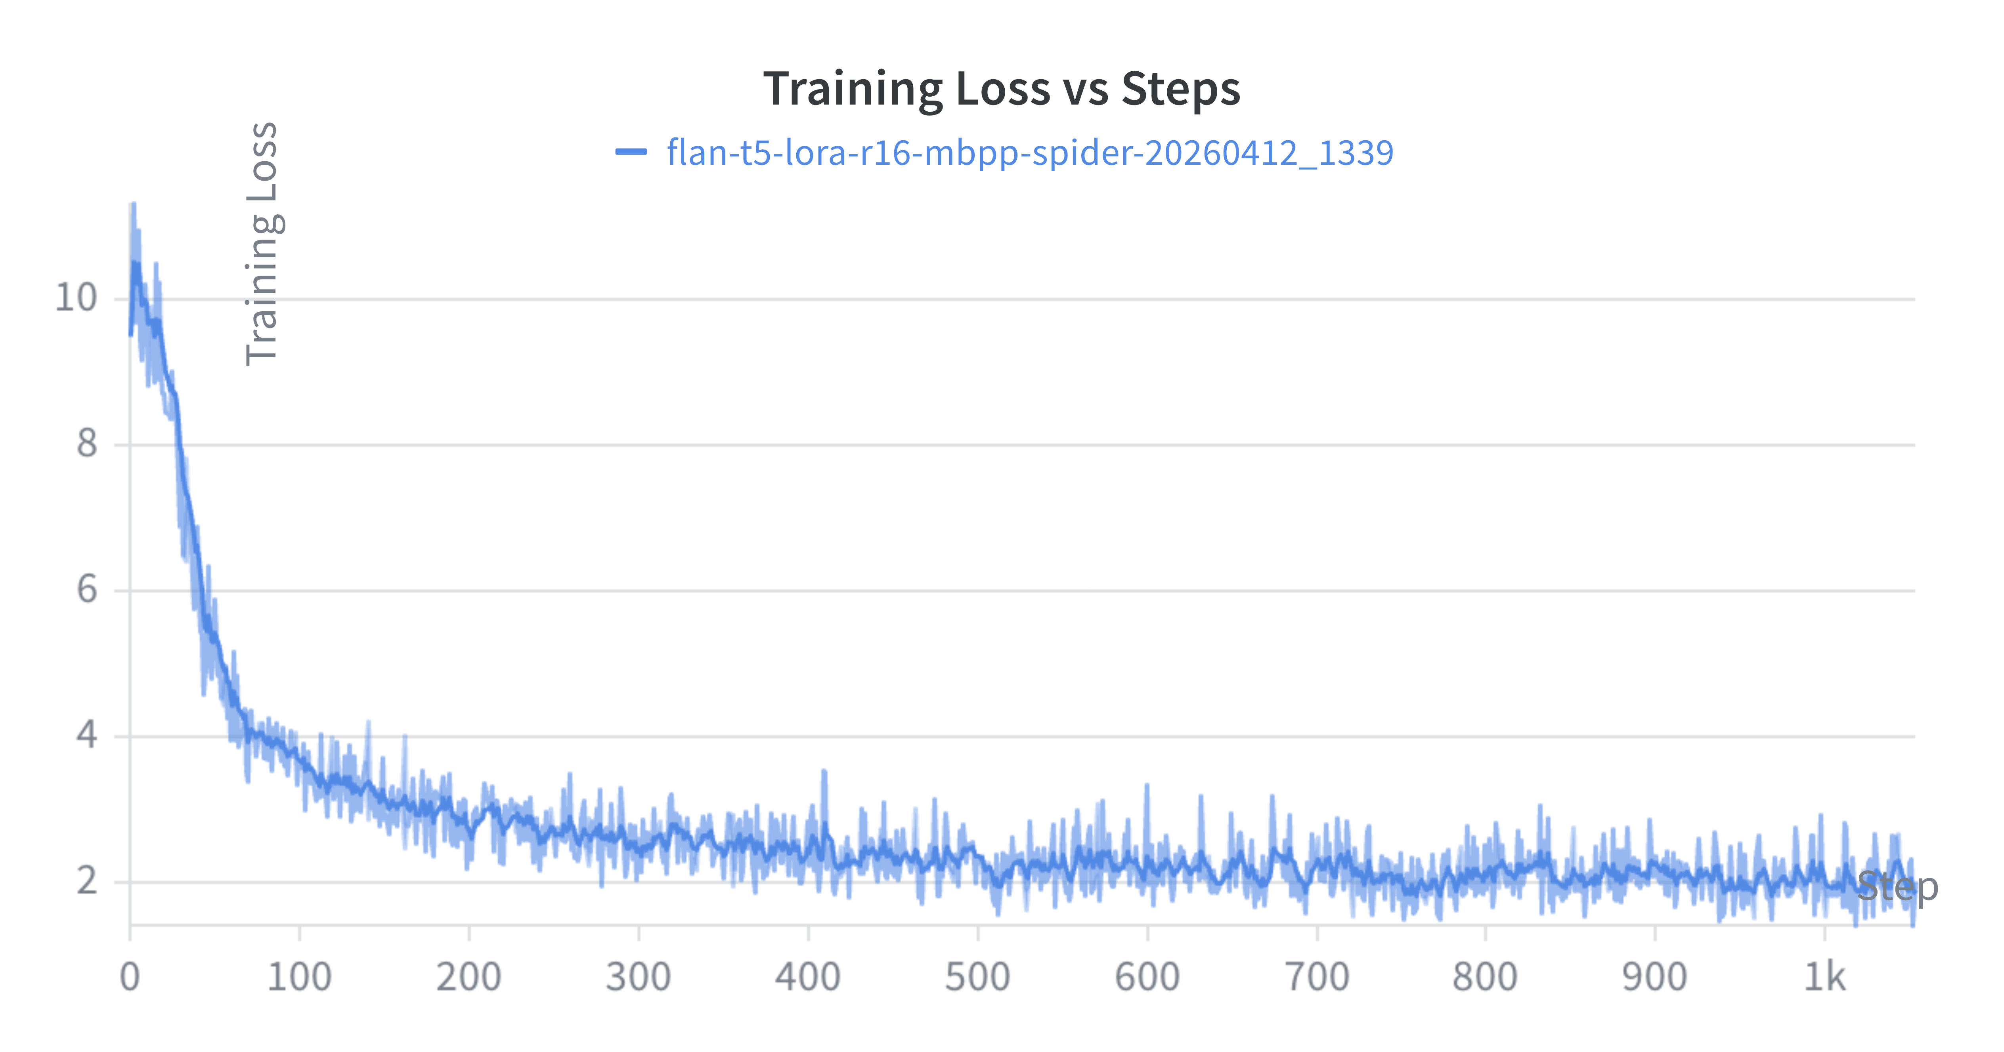
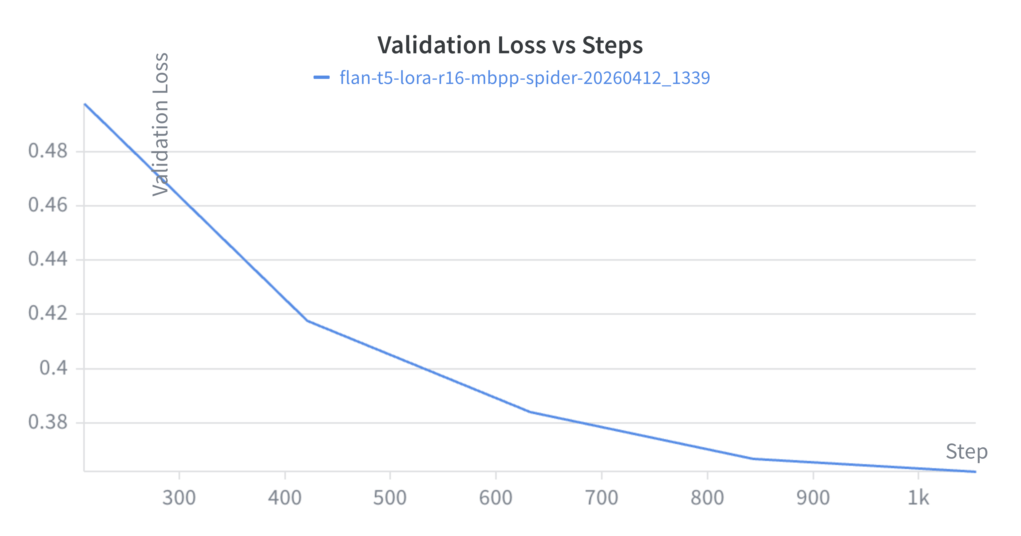
Training Progress — ~1,000 Steps
Loss Trajectory
Training loss fell from ~11.0 to ~2.0. Validation loss decreased steadily from 0.49 to 0.37 — no overfitting observed across ~1,000 steps.
Overlap Metrics
ROUGE-1: 0.605 → 0.710 (+17.4%)
ROUGE-L: 0.575 → 0.690 (+20.0%)
All metrics improved consistently, confirming effective learning from LoRA adaptation.

Slide 5
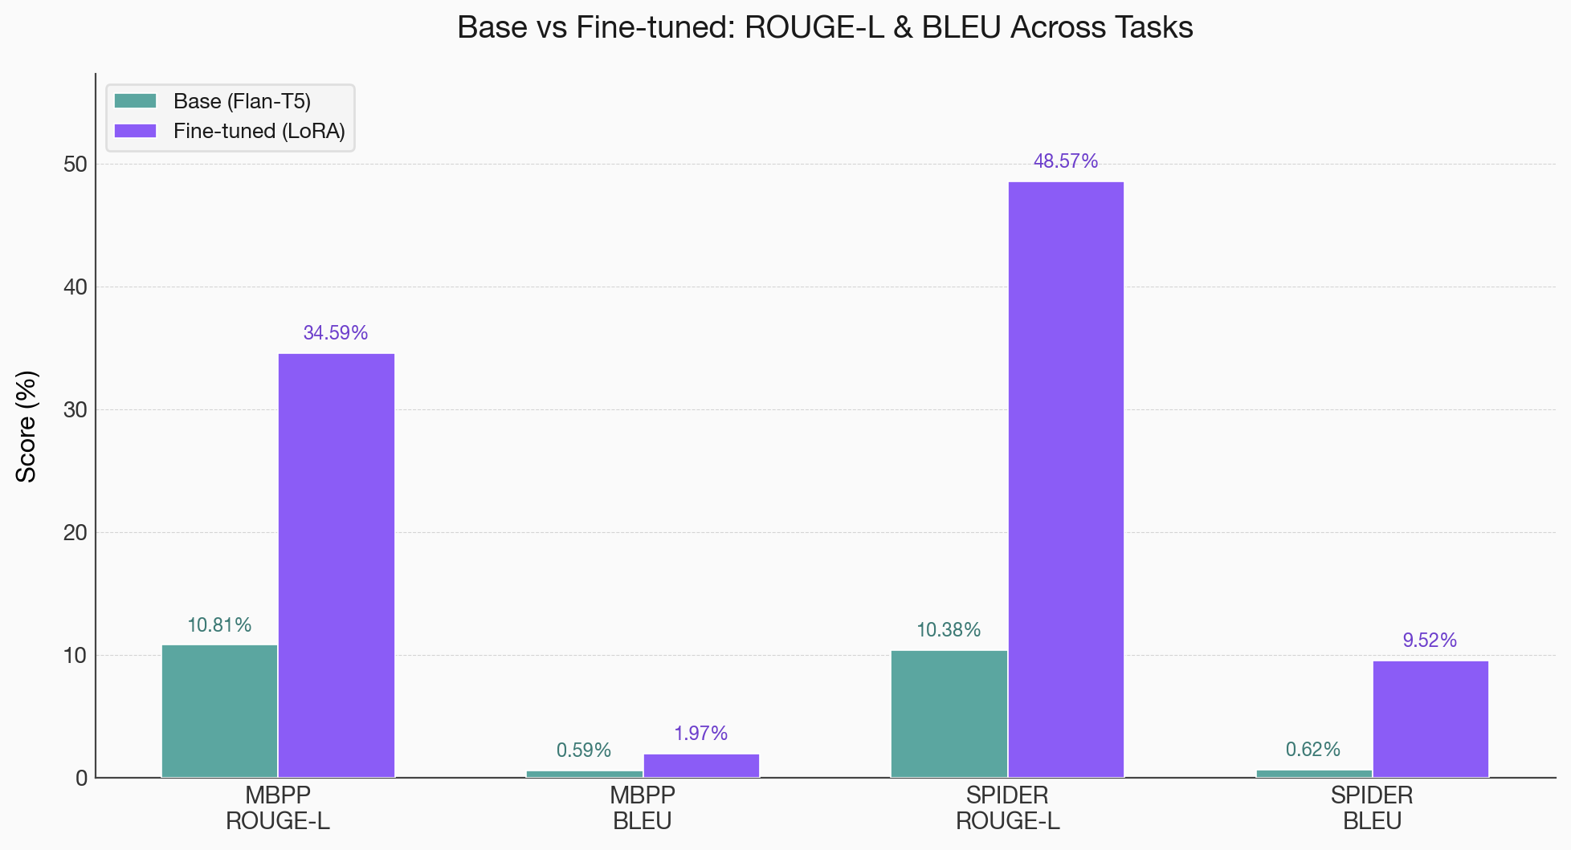
Evaluation: Base vs Fine-Tuned (LoRA)
MBPP — Python Generation
ROUGE-L improved 3.2×; BLEU-2 improved 3.3×.
The model learned code-like patterns but failed to produce syntactically valid Python(Pass@1: 0% for both models).
SPIDER — Text-to-SQL
ROUGE-L improved 4.7×; BLEU-2 improved 15.4×.
SQL's constrained grammar was far more learnable than free-form Python(Exact Match: 0% → 1.93% strict / 2.53% relaxed).

Slide 6
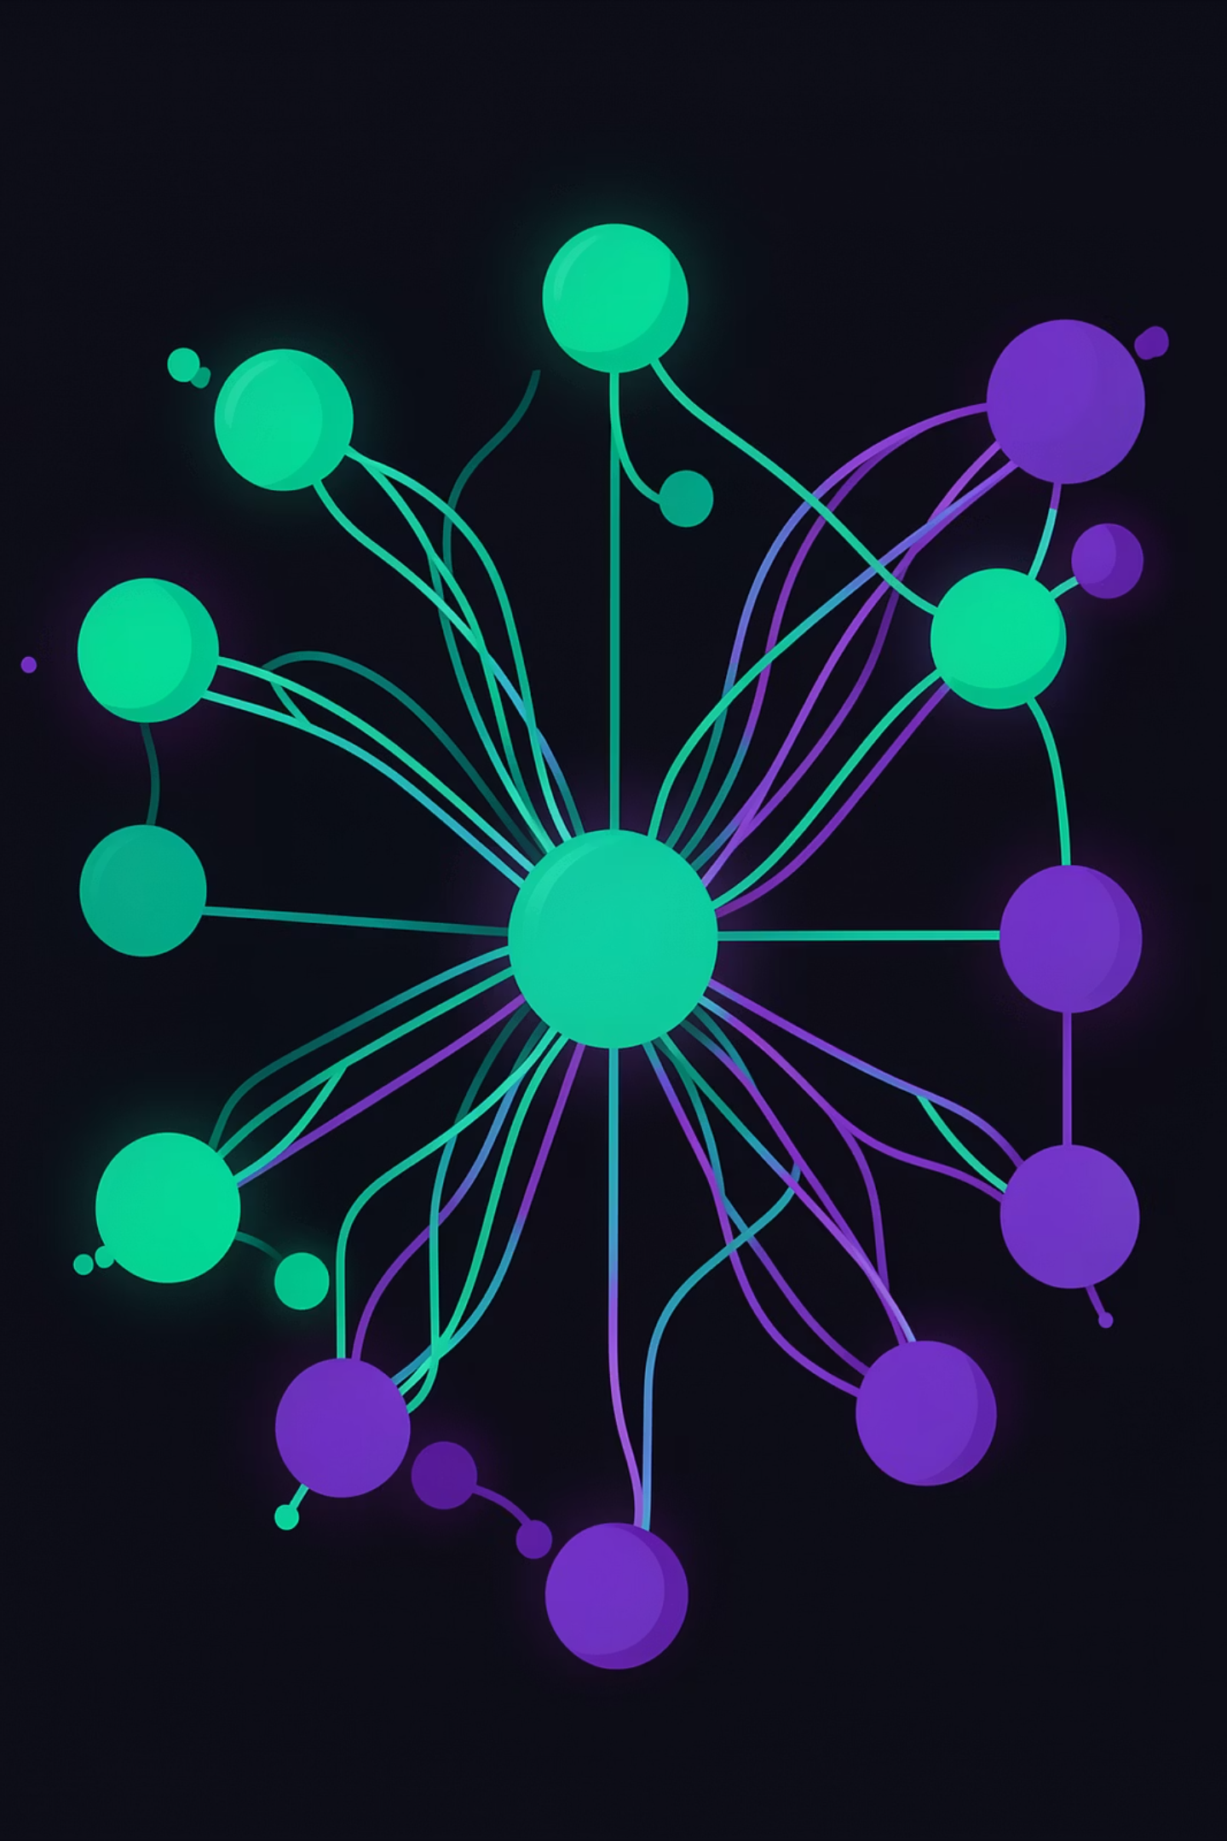
Key Takeaways & Future Work
LoRA is Highly Effective
1.4% trainable params yielded large gains in overlap metrics.
Task Structure Matters
Constrained SQL was far more learnable than open-ended Python for a 250M model.
Soft Metrics ≠ Correctness
High ROUGE-L with 0% Pass@1 shows lexical similarity ≠ executable code.
Data Imbalance Impact
15:1 SPIDER:MBPP ratio likely amplified SQL performance.
Future Directions
Code-specialized bases: CodeT5+, StarCoder
Higher LoRA rank, augmented MBPP data
Syntax-constrained decoding for valid output

Slide 7
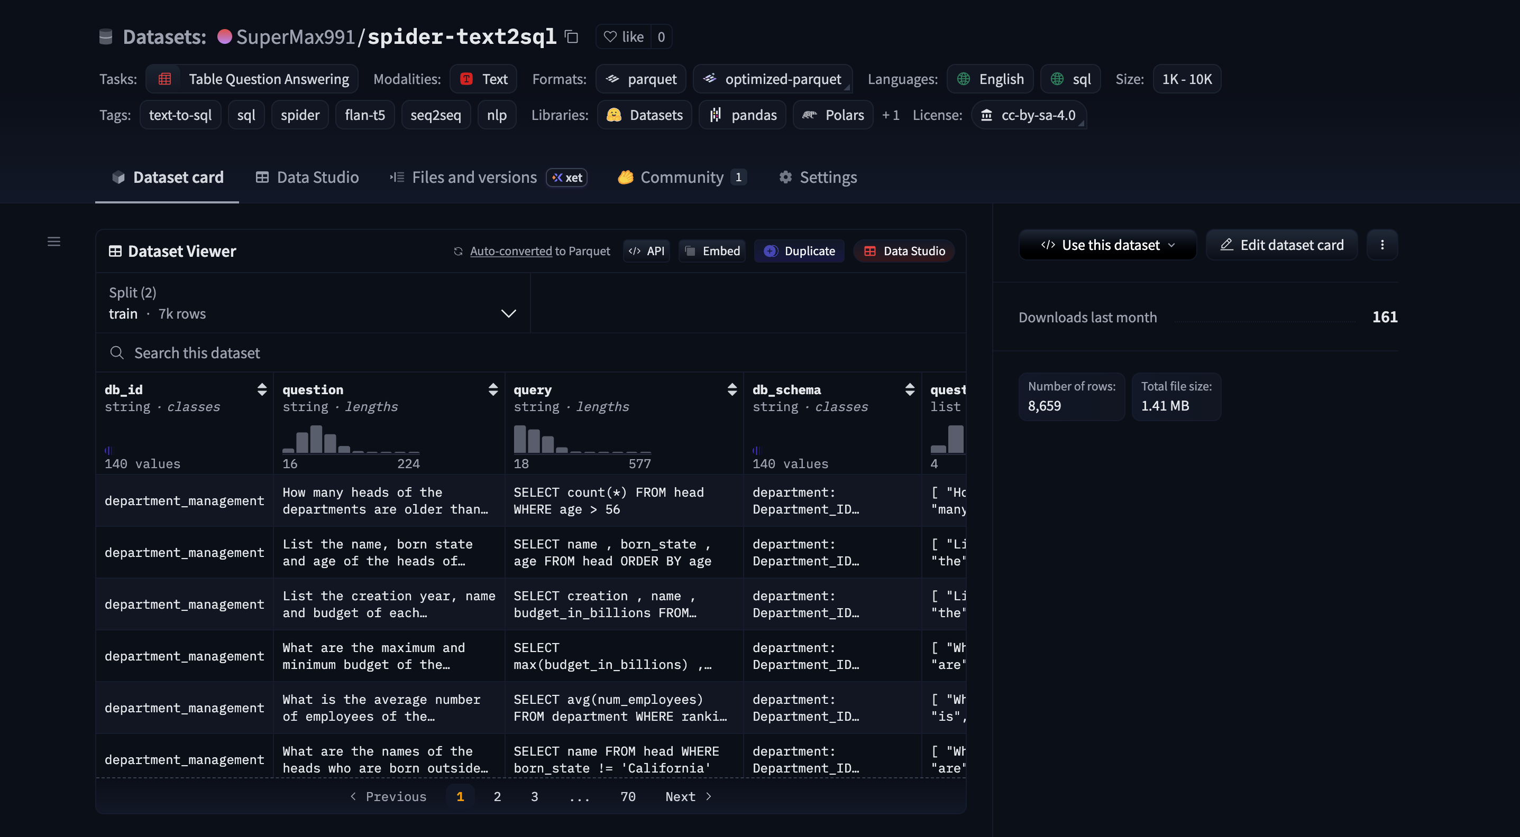
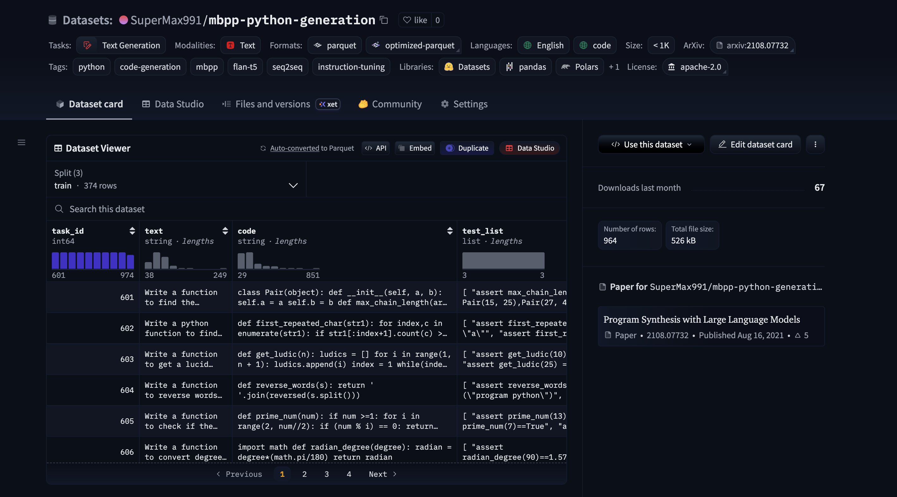
Datasets uploaded to HF
Spider-text2sql:
https://huggingface.co/datasets/SuperMax991/spider-text2sql
MBPP — Python Generation:
https://huggingface.co/datasets/SuperMax991/mbpp-python-generation

